Slide 1
CREATE SLIDES WITH A BACKGROUND FILL WITH PICTURE
COPY THE OVALS FROM SLIDE 3
ROTATE THE OVALS
SELECT ALL SLIDES AND PUT A MORPH TRANSITION
THIS SHOULD BE THE OPENING SLIDE

Slide 2
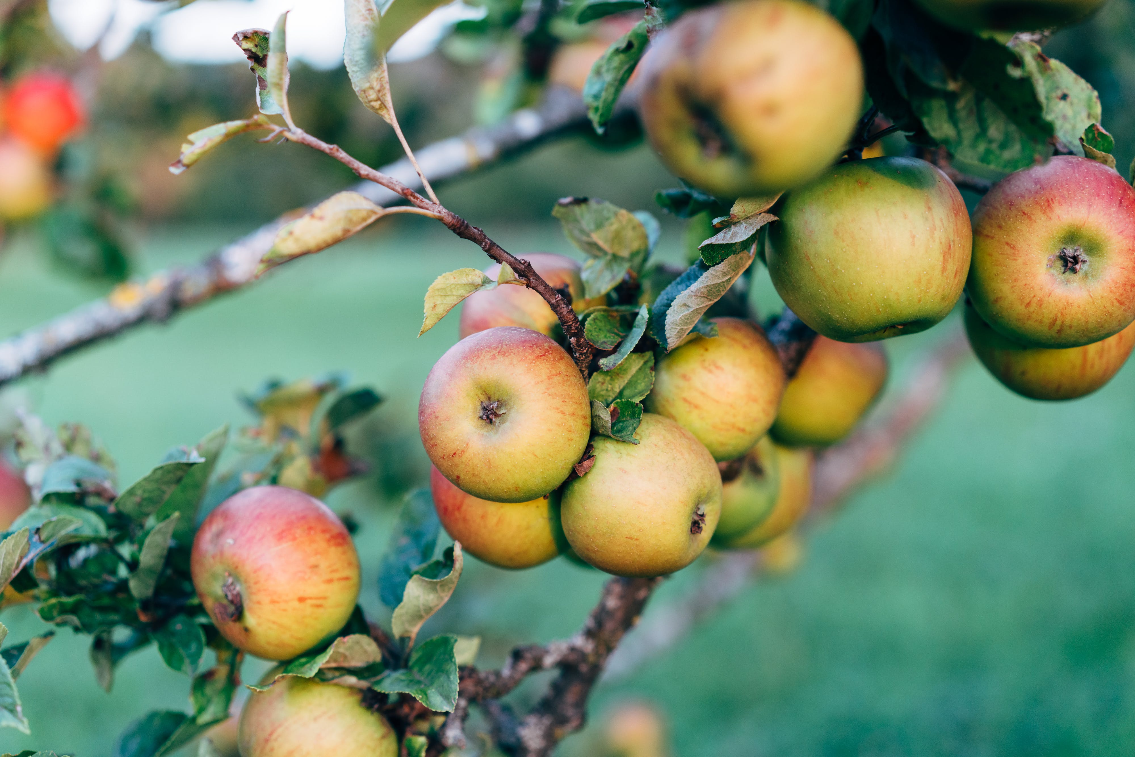
EAT APPLES
BE HEALTHY
GET SOME SUGAR

Slide 3
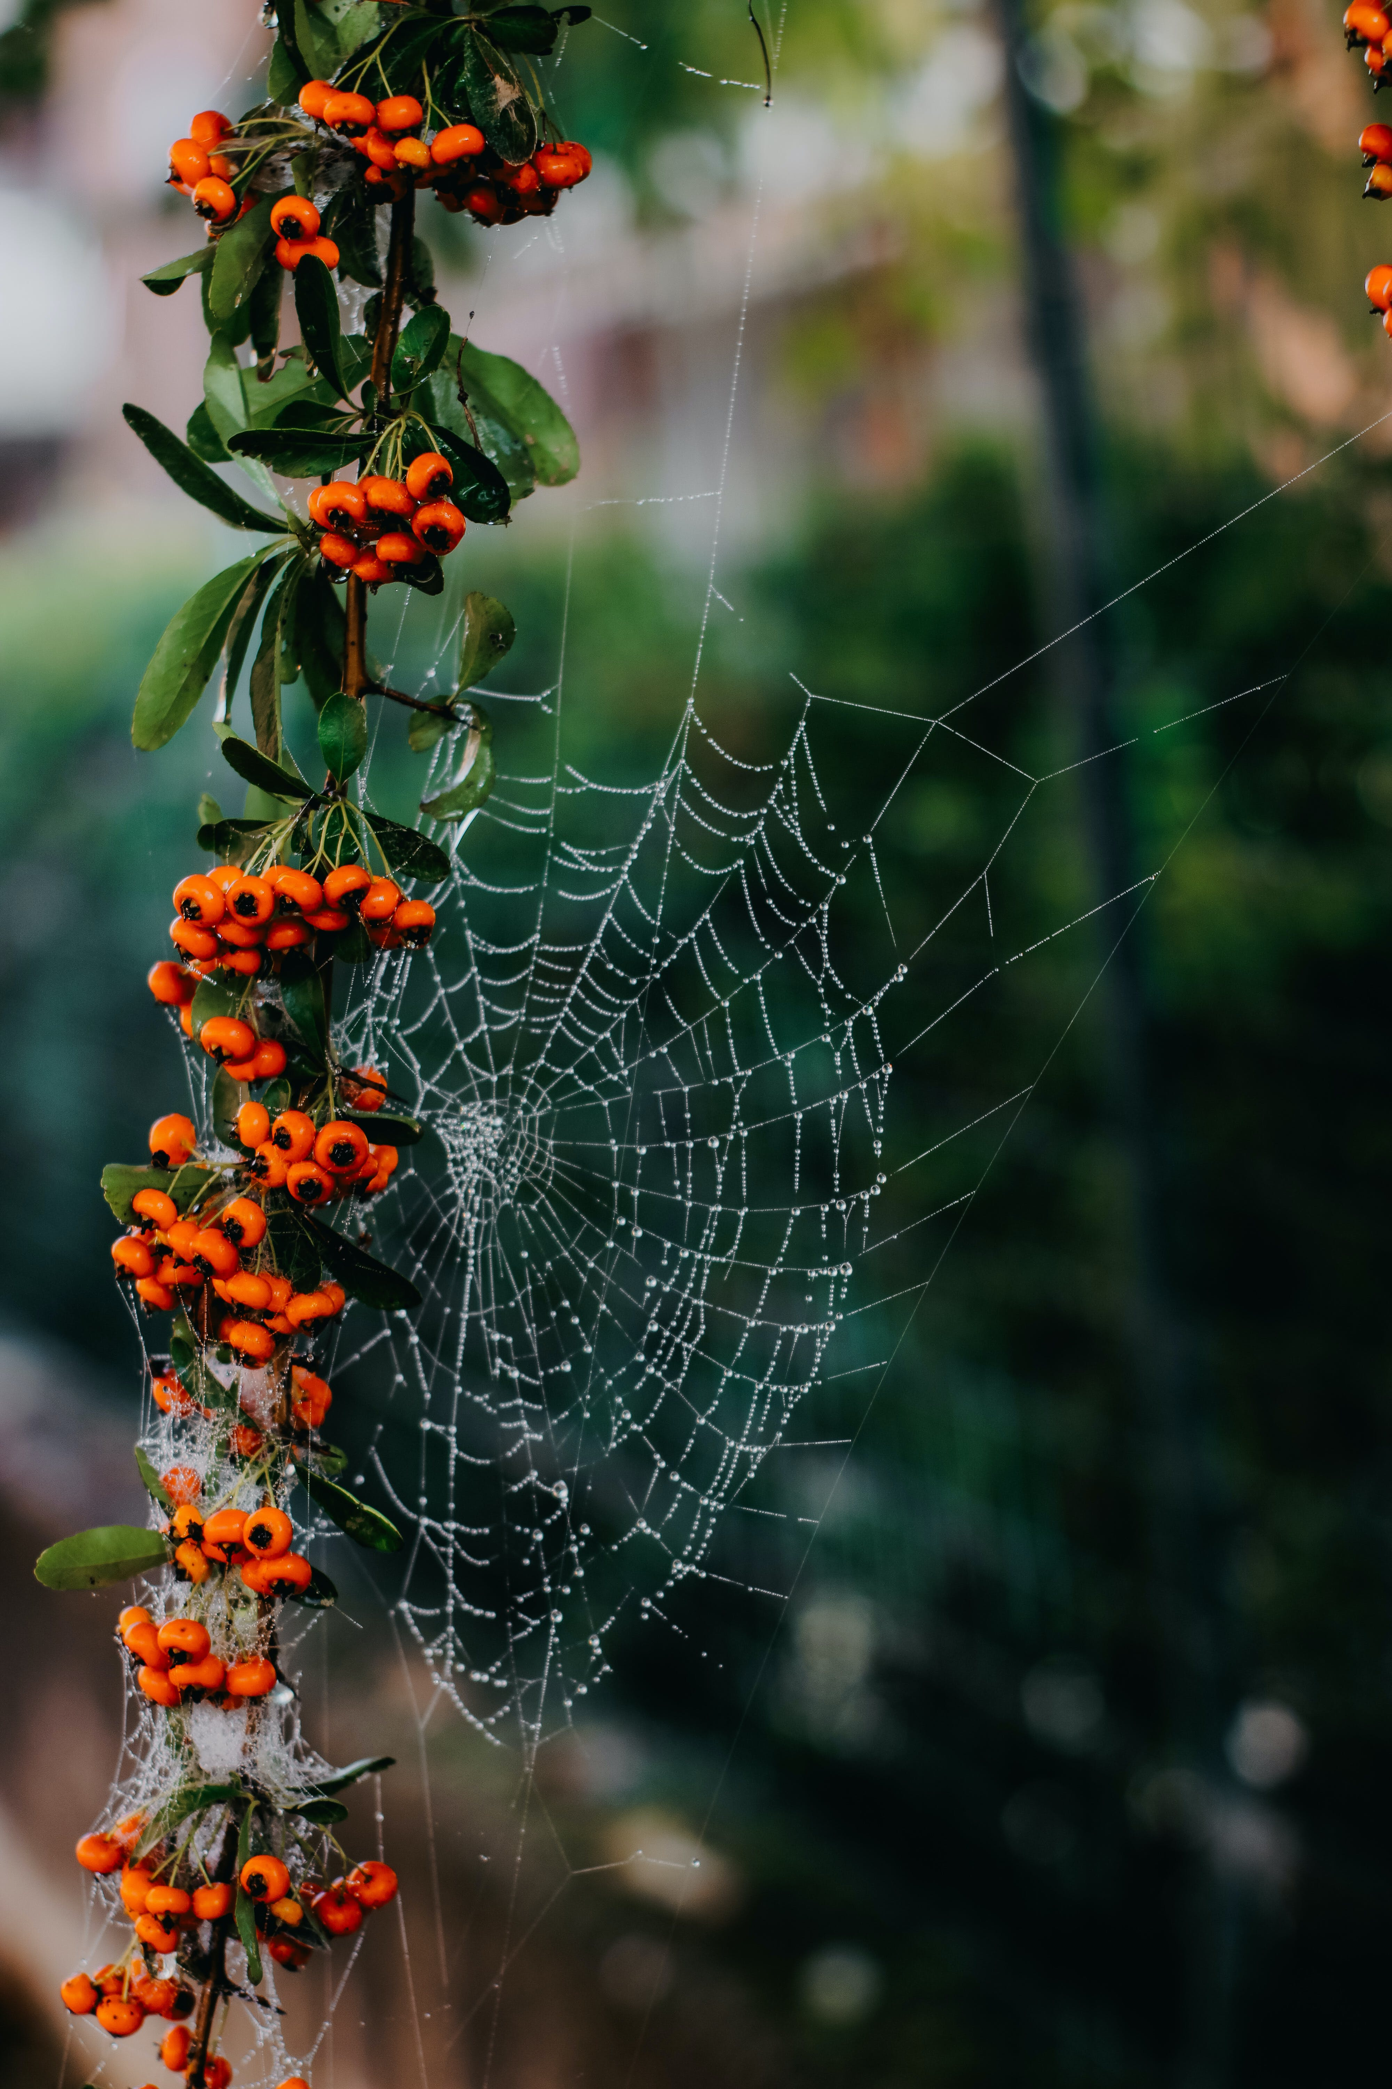
SPIDERS ARE NATURAL ARTISTS
BE CREATIVE

Slide 4
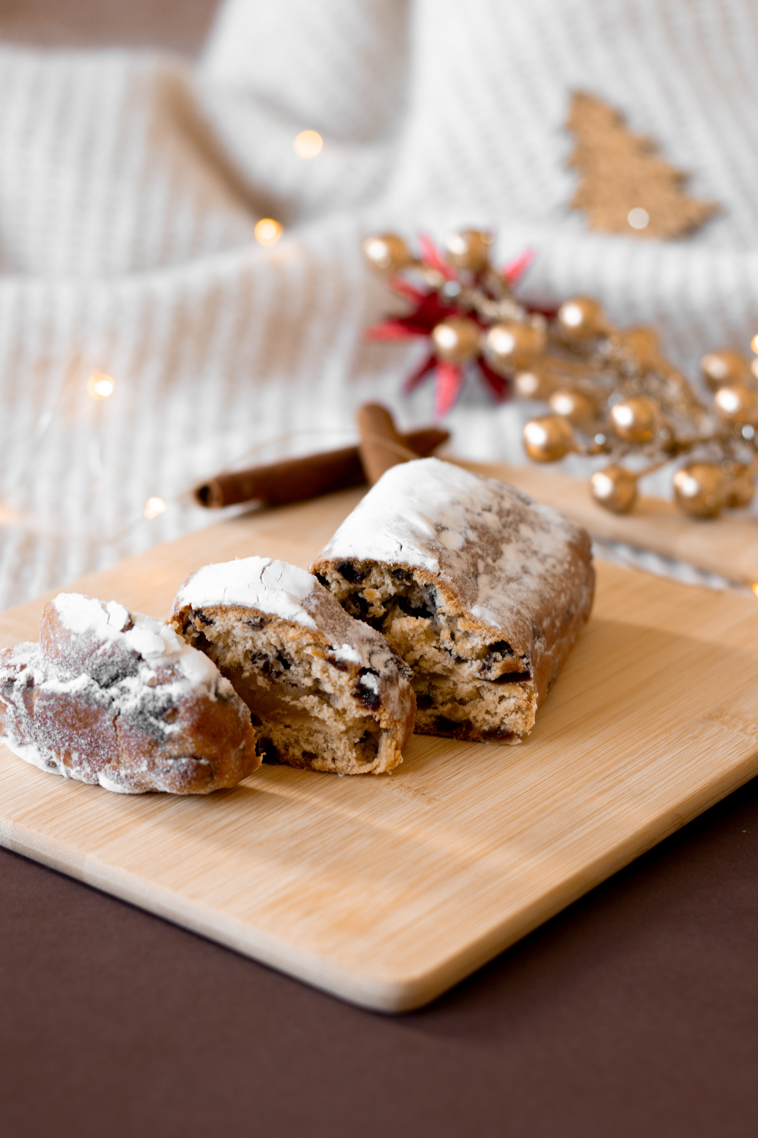
TIME FOR CHRISTMAS.
GATHER WITH FRIENDS

Slide 5
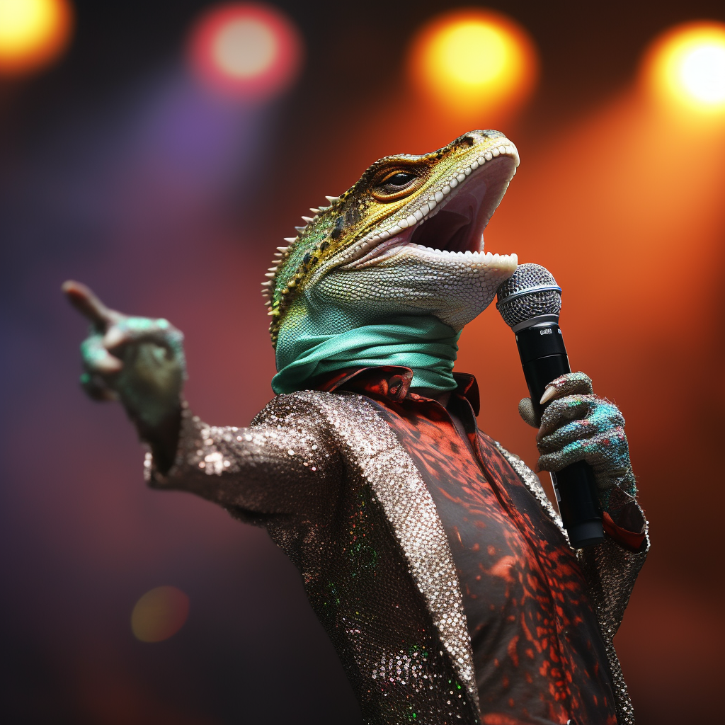
LIZZARD IN A KARAOKE. CAN IT GET BETTER THAN THIS???

